Slide 1
Image Segmentation
Sobel edge detector, Otsu threshold, U-Net

Slide 2
Problem Statement
I aim of the project is to build a Deep Learning model for segmentation masking of different parts of an image.
The model takes an input in form of image and implement various thresholding algorithm to segregate between different parts of the image (foreground + background + border).
Finally give a color coded mapping of the different segments of the image.

Slide 3
Introduction to Image Segmentation
Image segmentation is the process of partitioning an image into multiple segments, where each segment represents a distinct object or region.
Segmentation can be based on various criteria, such as color, intensity, texture, or a combination of these factors.
Highly significant in computer vision, medical imaging, autonomous vehicles, and various other applications

Slide 4
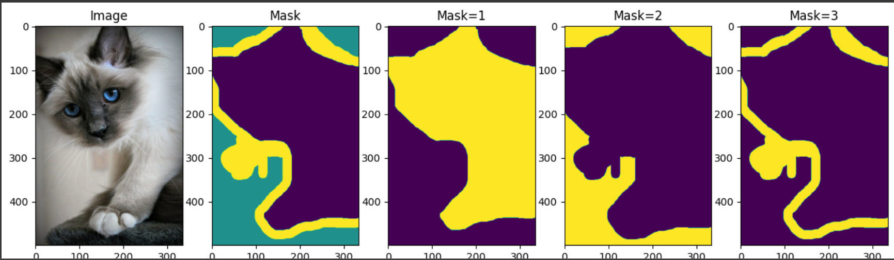
Examples
The above example shows a sample segmentation masking of a cat image, where different masking label in form of (1,2,3) (i.e. foreground, background and border) of the image.

Slide 5
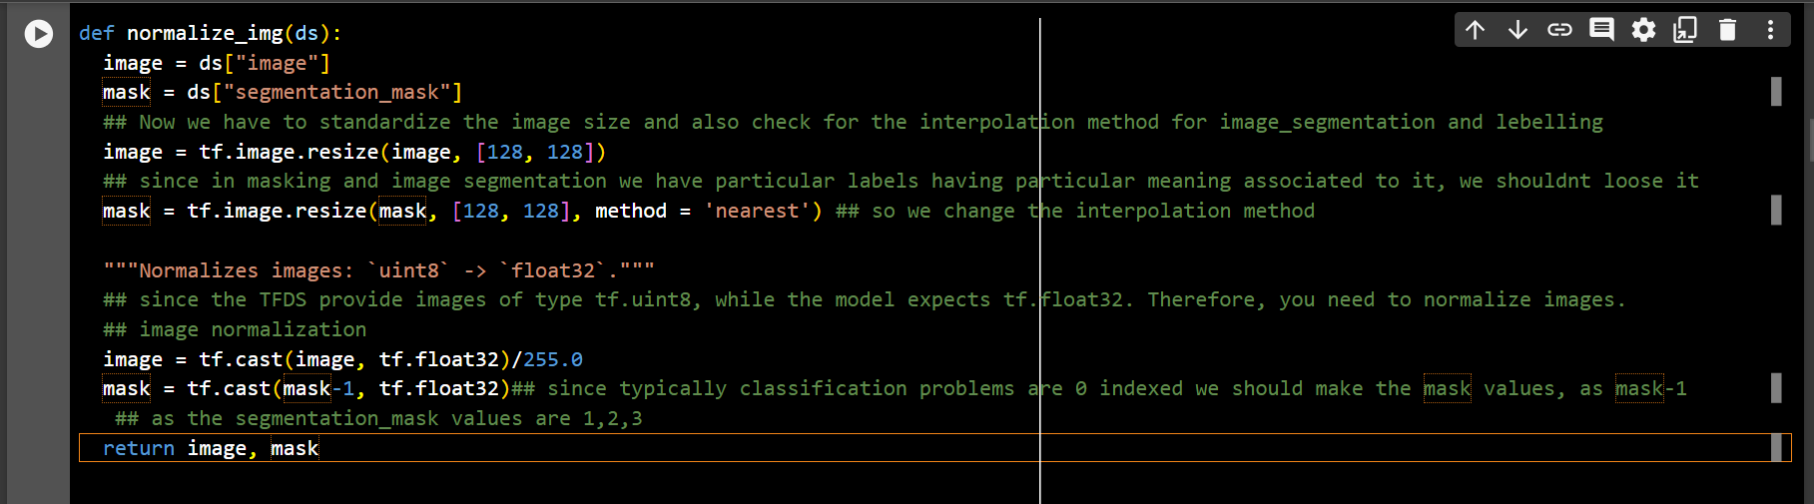
Image Pre-processing code
The above code shows how:-
The image is resized into the standard size of (128X128)
Image normalization for bringing all the data to a similar level.
Converting the masking into 0-indexing masking segmentation.

Slide 6
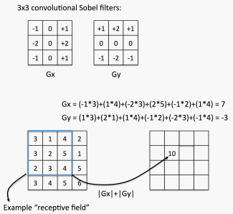
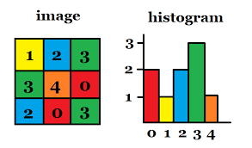
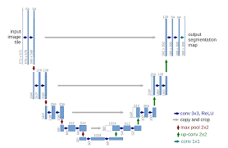
Techniques Used
Sobel Filters
Otsu Thresholding
U-Net

Slide 7
Sobel Operator for Edge Detection
The Sobel operator is a convolutional filter used for detecting edges in an image.
It highlights areas of rapid intensity change, which often correspond to object boundaries or edges.
Sobel is particularly effective in highlighting edges, making it a valuable pre-processing step for image segmentation.

Slide 8
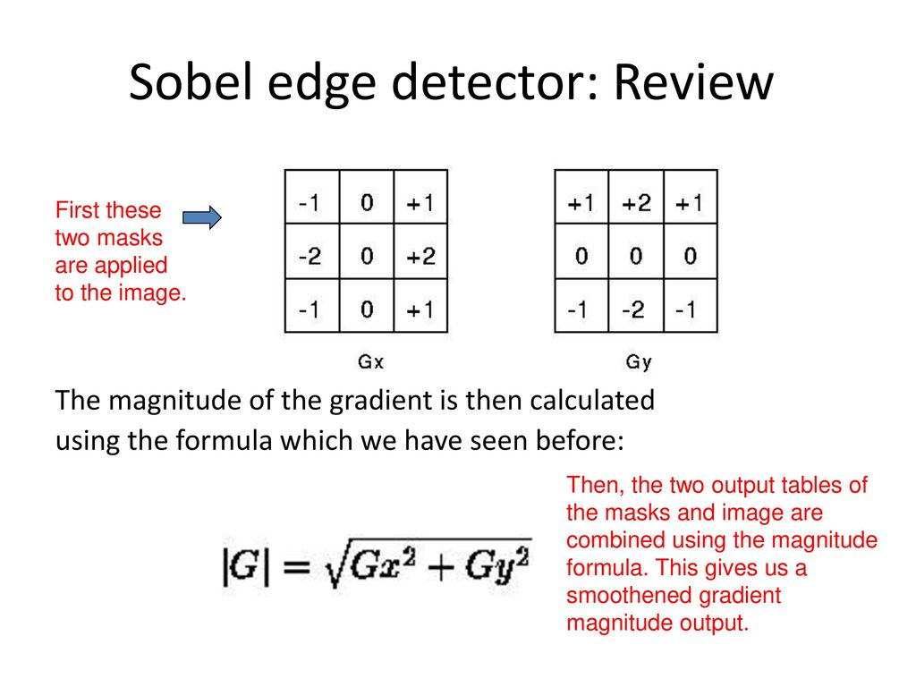
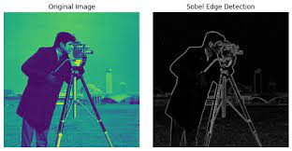
Sobel Edge Detection in Play

Slide 9
Advantages and Limitations
Advantages: Simple and computationally efficient, especially for real-time applications.
Limitations: Sensitive to noise, and may produce thick edges in the presence of intensity variations. It will detect edges in the background also.

Slide 10
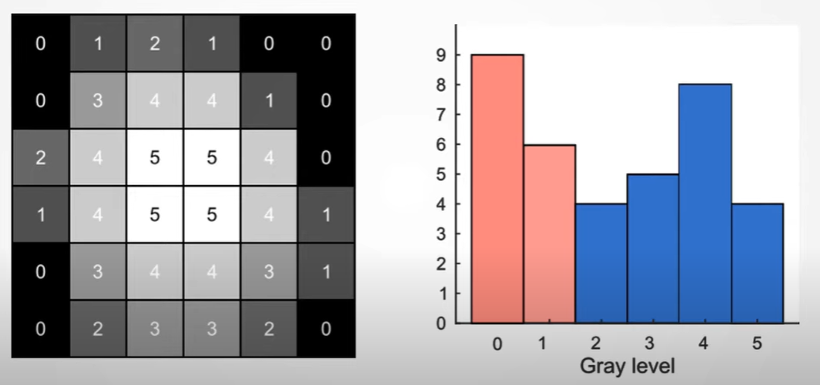
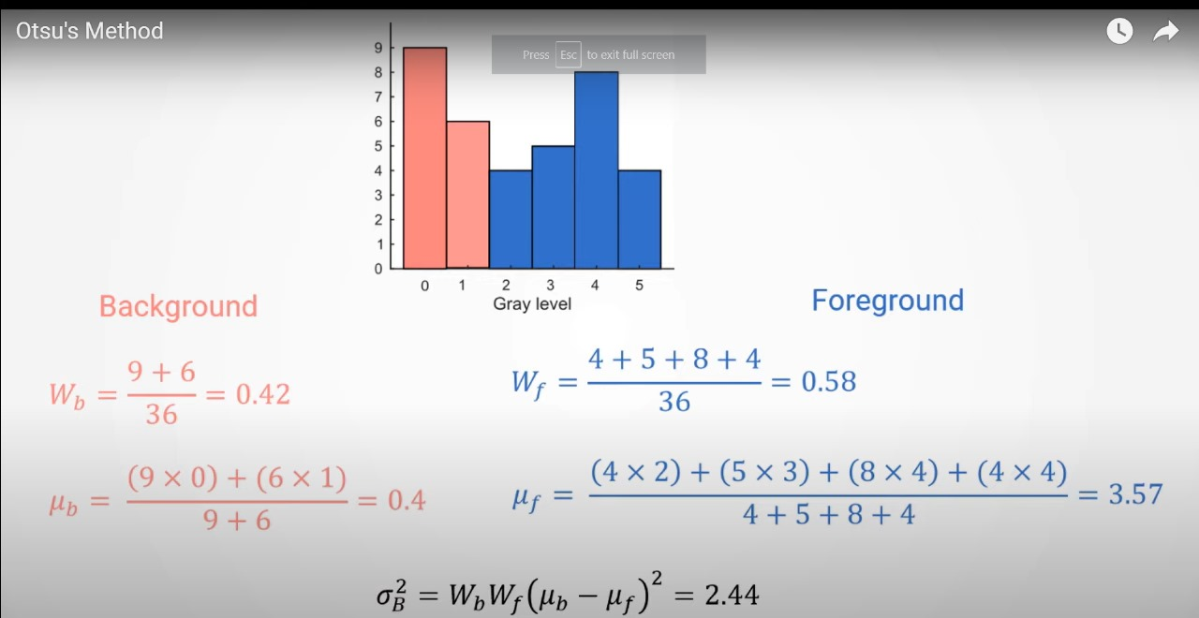
Otsu’s Thresholding
Otsu's method is an image
thresholding technique that
automatically determines
the optimal threshold to
separate an image into
foreground and background
Regions.
In the context of image
segmentation, thresholding
involves converting a grayscale
image into a binary image.

Slide 11
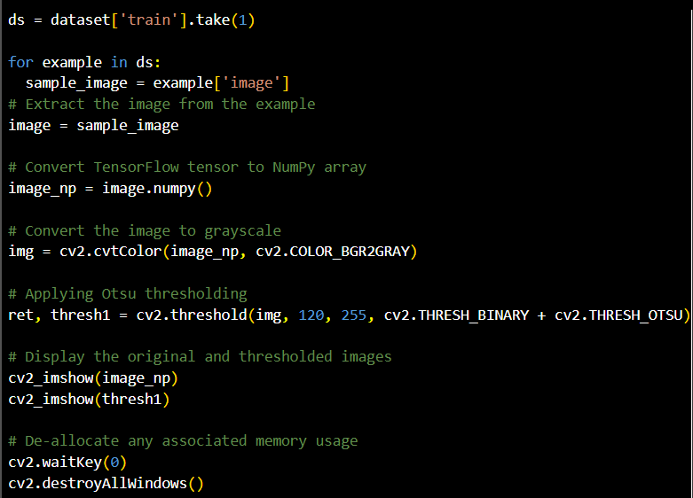
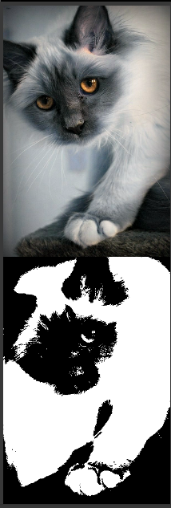

Code Snippet and output of Otsu Thresholding

Slide 12
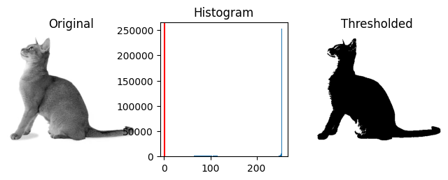
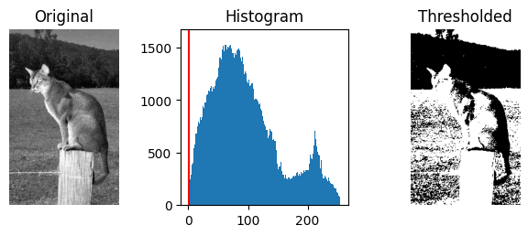
Advantage and Limitations
Advantages: Automatically determines the threshold, making it suitable for images with varying contrast.
Limitations: May not perform well in the presence of complex backgrounds or overlapping intensity distributions.

Slide 13
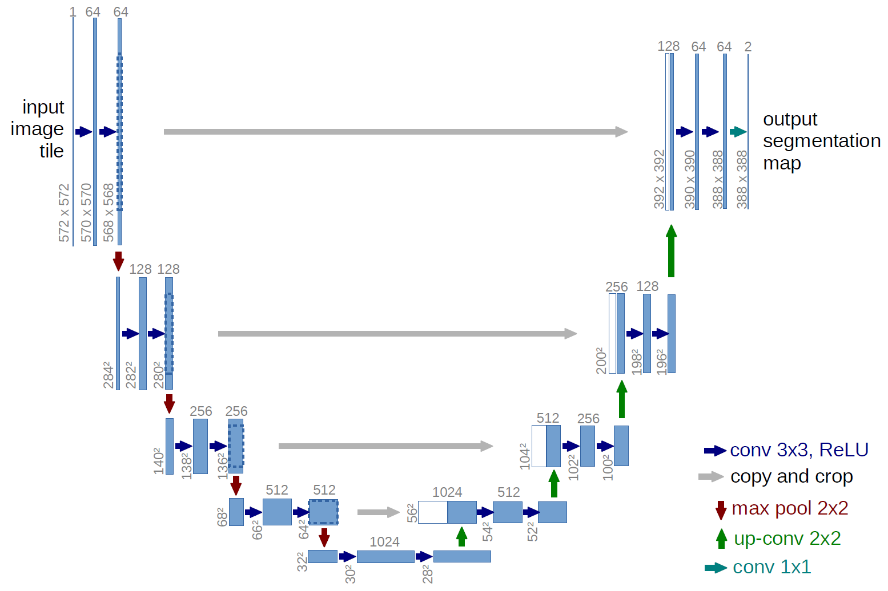
U-Net Architecture
The U-Net architecture is a powerful convolutional neural network (CNN) designed for semantic segmentation tasks. Its distinctive U-shaped structure, with a contracting path followed by an expansive path, allows it to capture intricate details while maintaining spatial information.

Slide 14
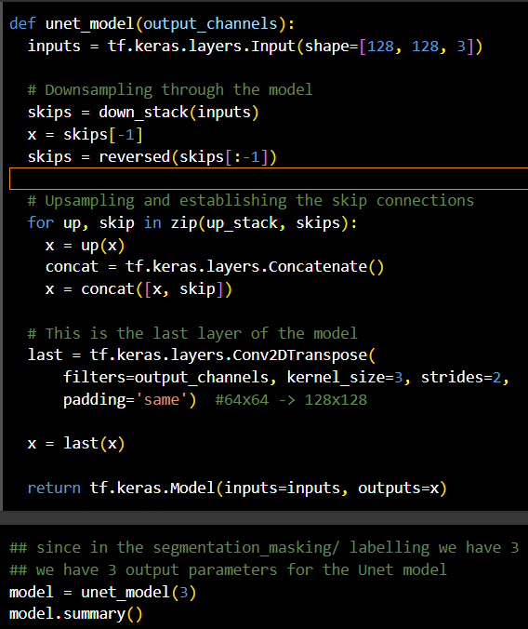
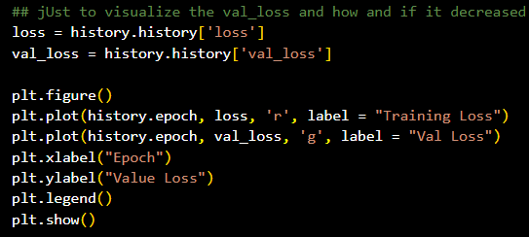
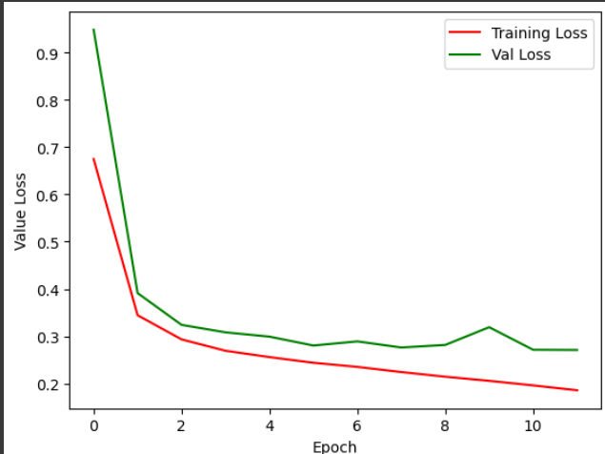
U-net Model Building value loss over the epochs

Slide 15
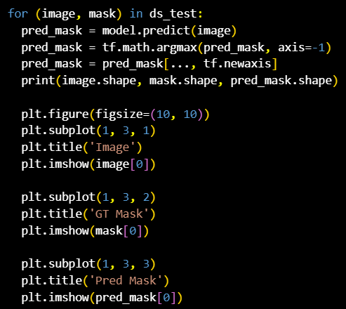
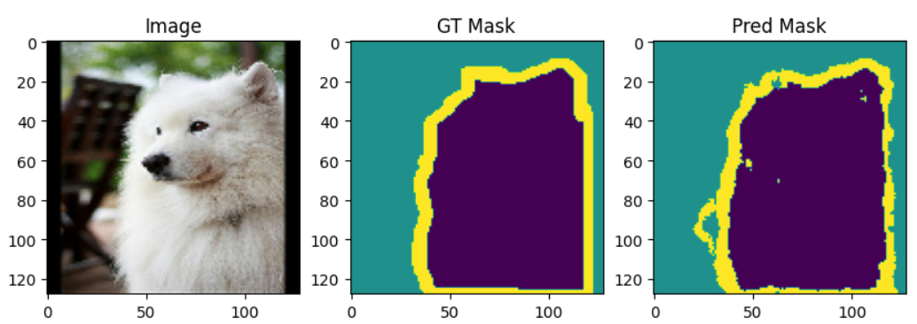
U-net Model Building & Output

Slide 16
Advantages and Limitations
Advantages: Accurately classifies pixels in semantic segmentation tasks.
Disadvantages: Requires substantial computing resources due to depth and complexity.

Slide 17
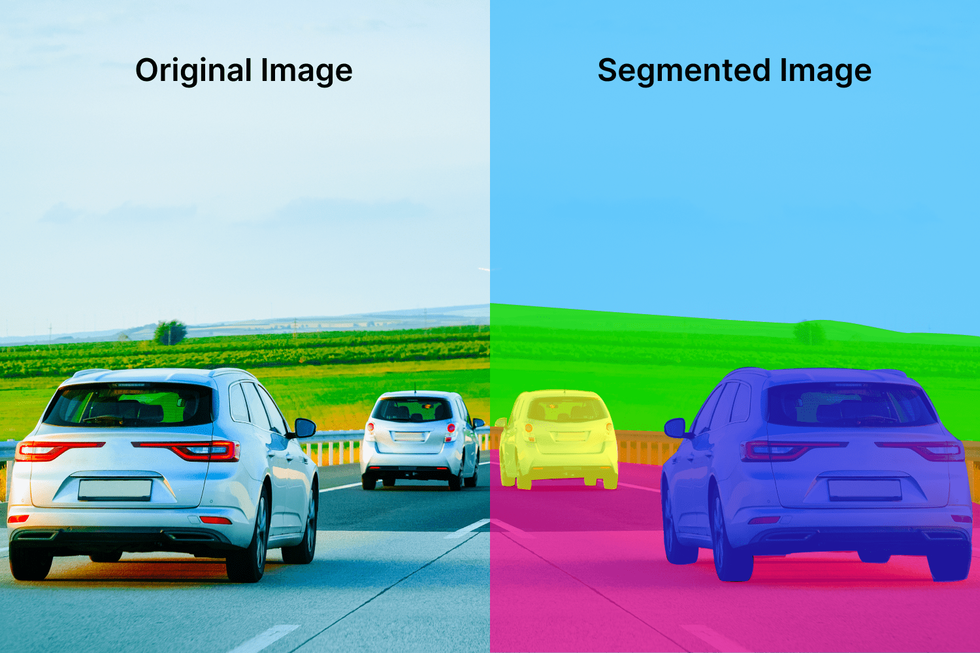
Real World Applications
Medical Image Segmentation
Satellite Image Analysis
Automated Object Recognition
Robotics and Autonomous Systems
Building automatic defence system.

Slide 18
Conclusion
Understanding the challenges and considerations in image segmentation is critical for selecting the right method and optimizing performance.
While Sobel and otsu require less computation power, they are not suitable for fine granularities.
On the other hand U-Net require high computational power, so need to optimize it to use it in real time.

Slide 19
My Biggest Learnings
The biggest personal learning that I take away from this project is the fact that inspite of not having the entire theoretical understanding of the concepts, in ML it is probably just better to jump in and start implementing practical projects for a to-and-fro (forward and backward propagation) kinda learning approach.
The 3 biggest technical learnings from this project:-
The transformation of unstructured dataset and how to work around tensorflow datasets and image pre-processing for retaining the most amount of information.
The process of re-sizing, segmentation-masking and using various thresholding algorithms for a clear cut segregation of the different parts of the image.
The usage of various model building techniques from the development of the most naive sequential neural network -> functional API based tensorflow/ sub-classing and finally the Mobile U-net architecture that we used for the implementation of our project.

